Slide 1
IOT PROJECT
Fiacre Byiringiro

Slide 2
Table of content
Introduction
Progress
Preparation
Phases
Used software
Results
Challenges
Summary

Slide 3

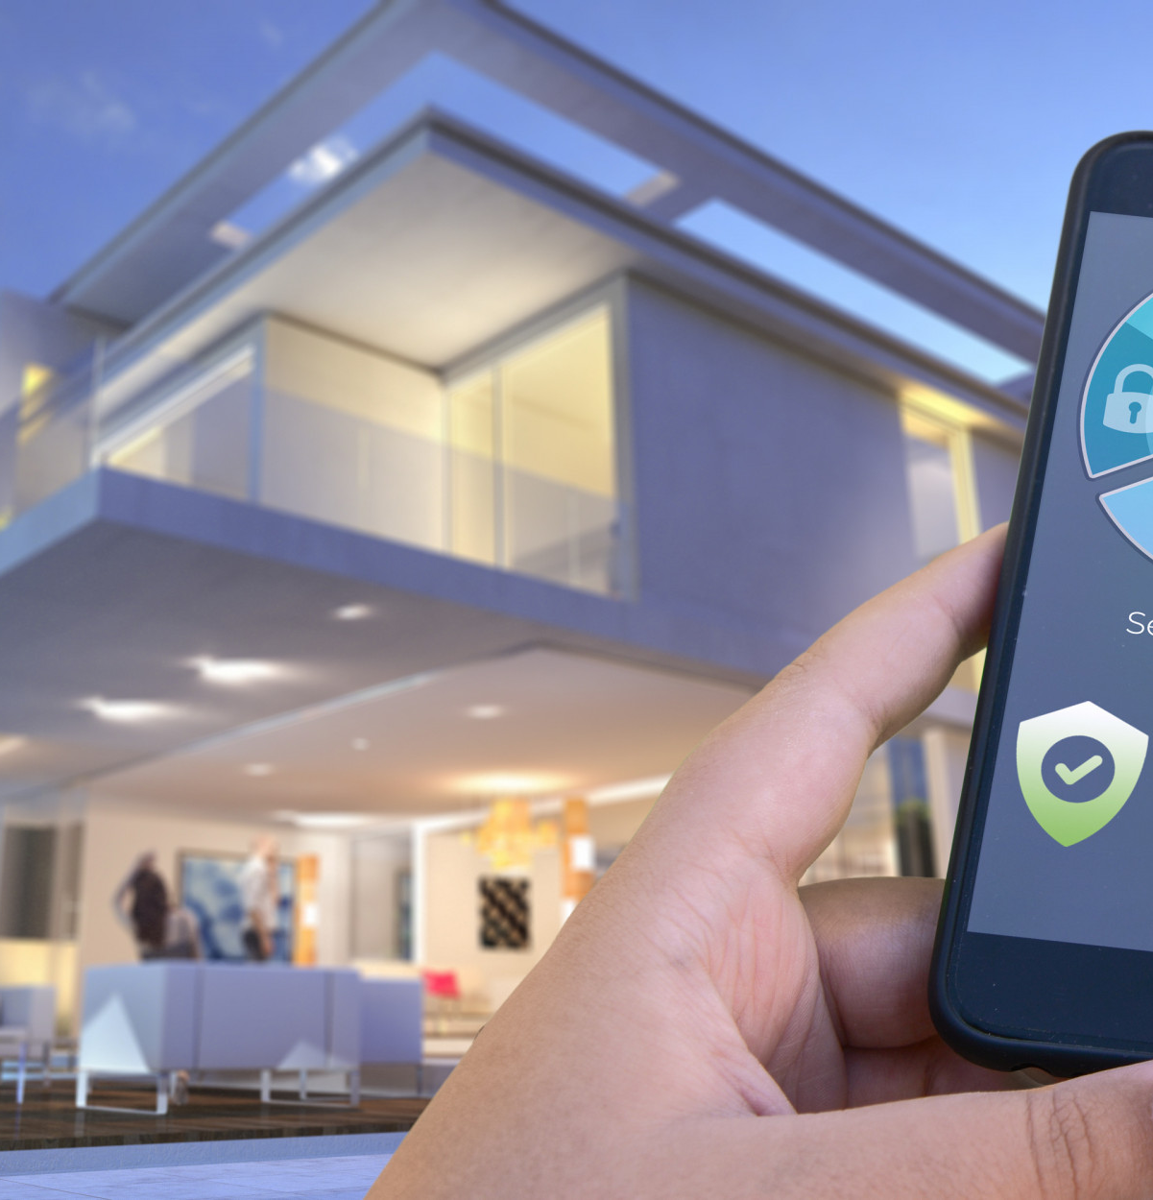
introduction
For this project, we needed :
To implement smart house features
Manipulate the temperature, humidity and light intensity values
Control the fan and change

Slide 4
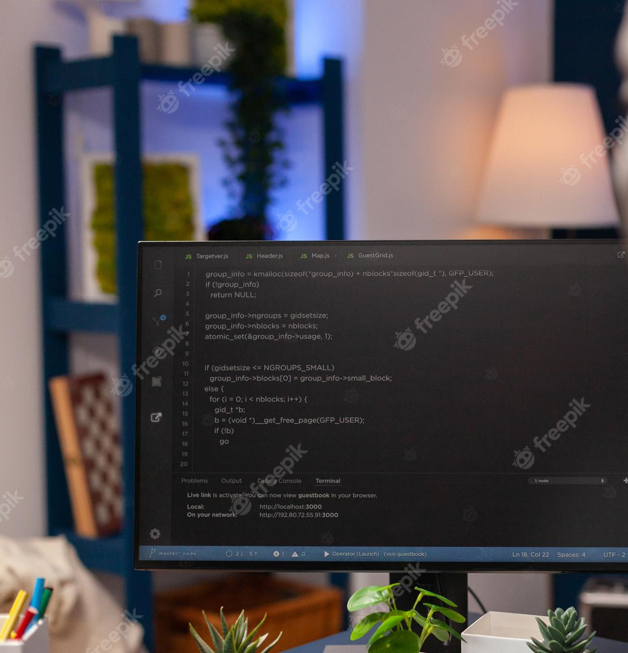
Progress
Project was delivered into 4 different phases:
Phase 1: Data capture for the light intensity
Phase 2: DHT-11 sensor, current temperature and humidity capture
Phase 3: Connect the photoresistor sensor to capture the light intensity
Phase 4: Transfer RFID tag information over the MQTT brokers
Final presentation

Slide 5

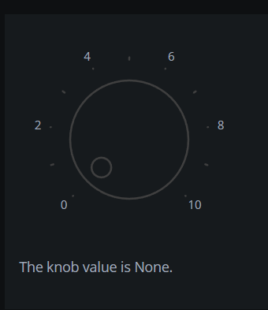
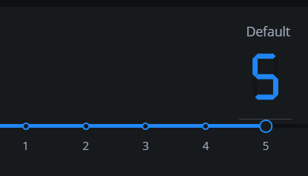
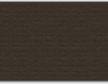
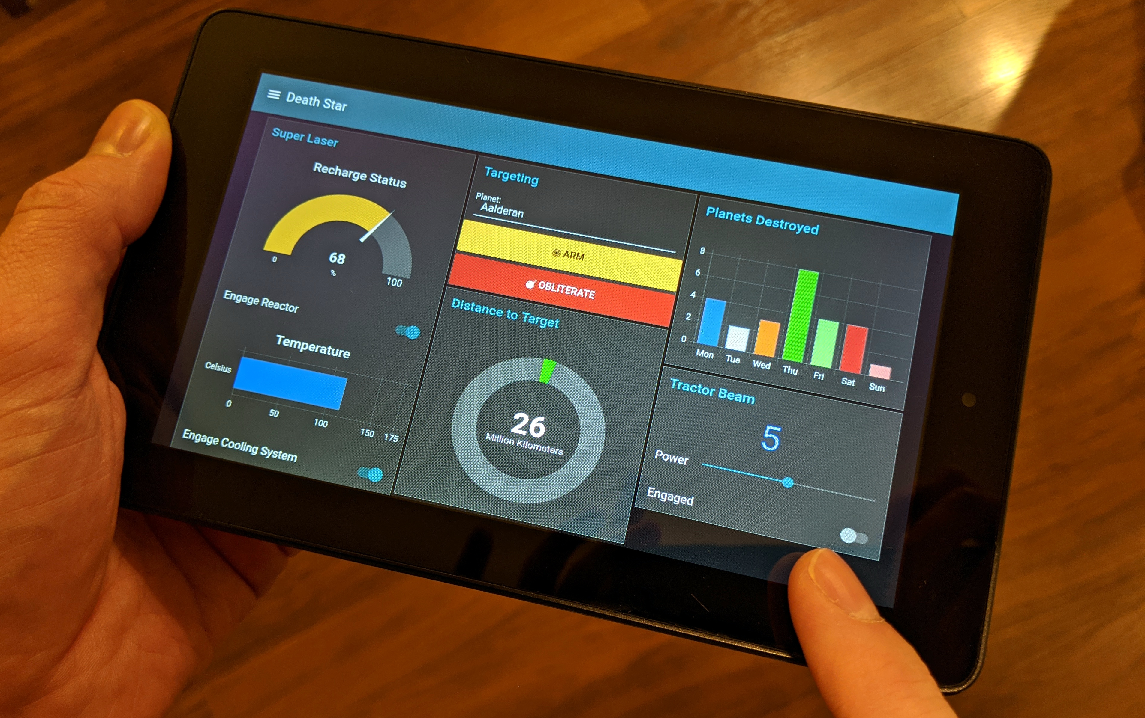
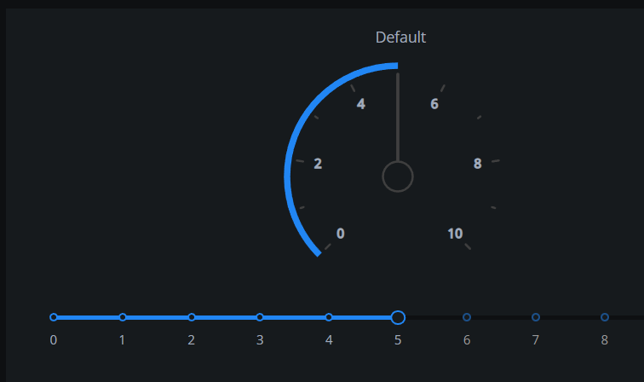
Preparation
I installed Python Dash components
Test these components

Slide 6
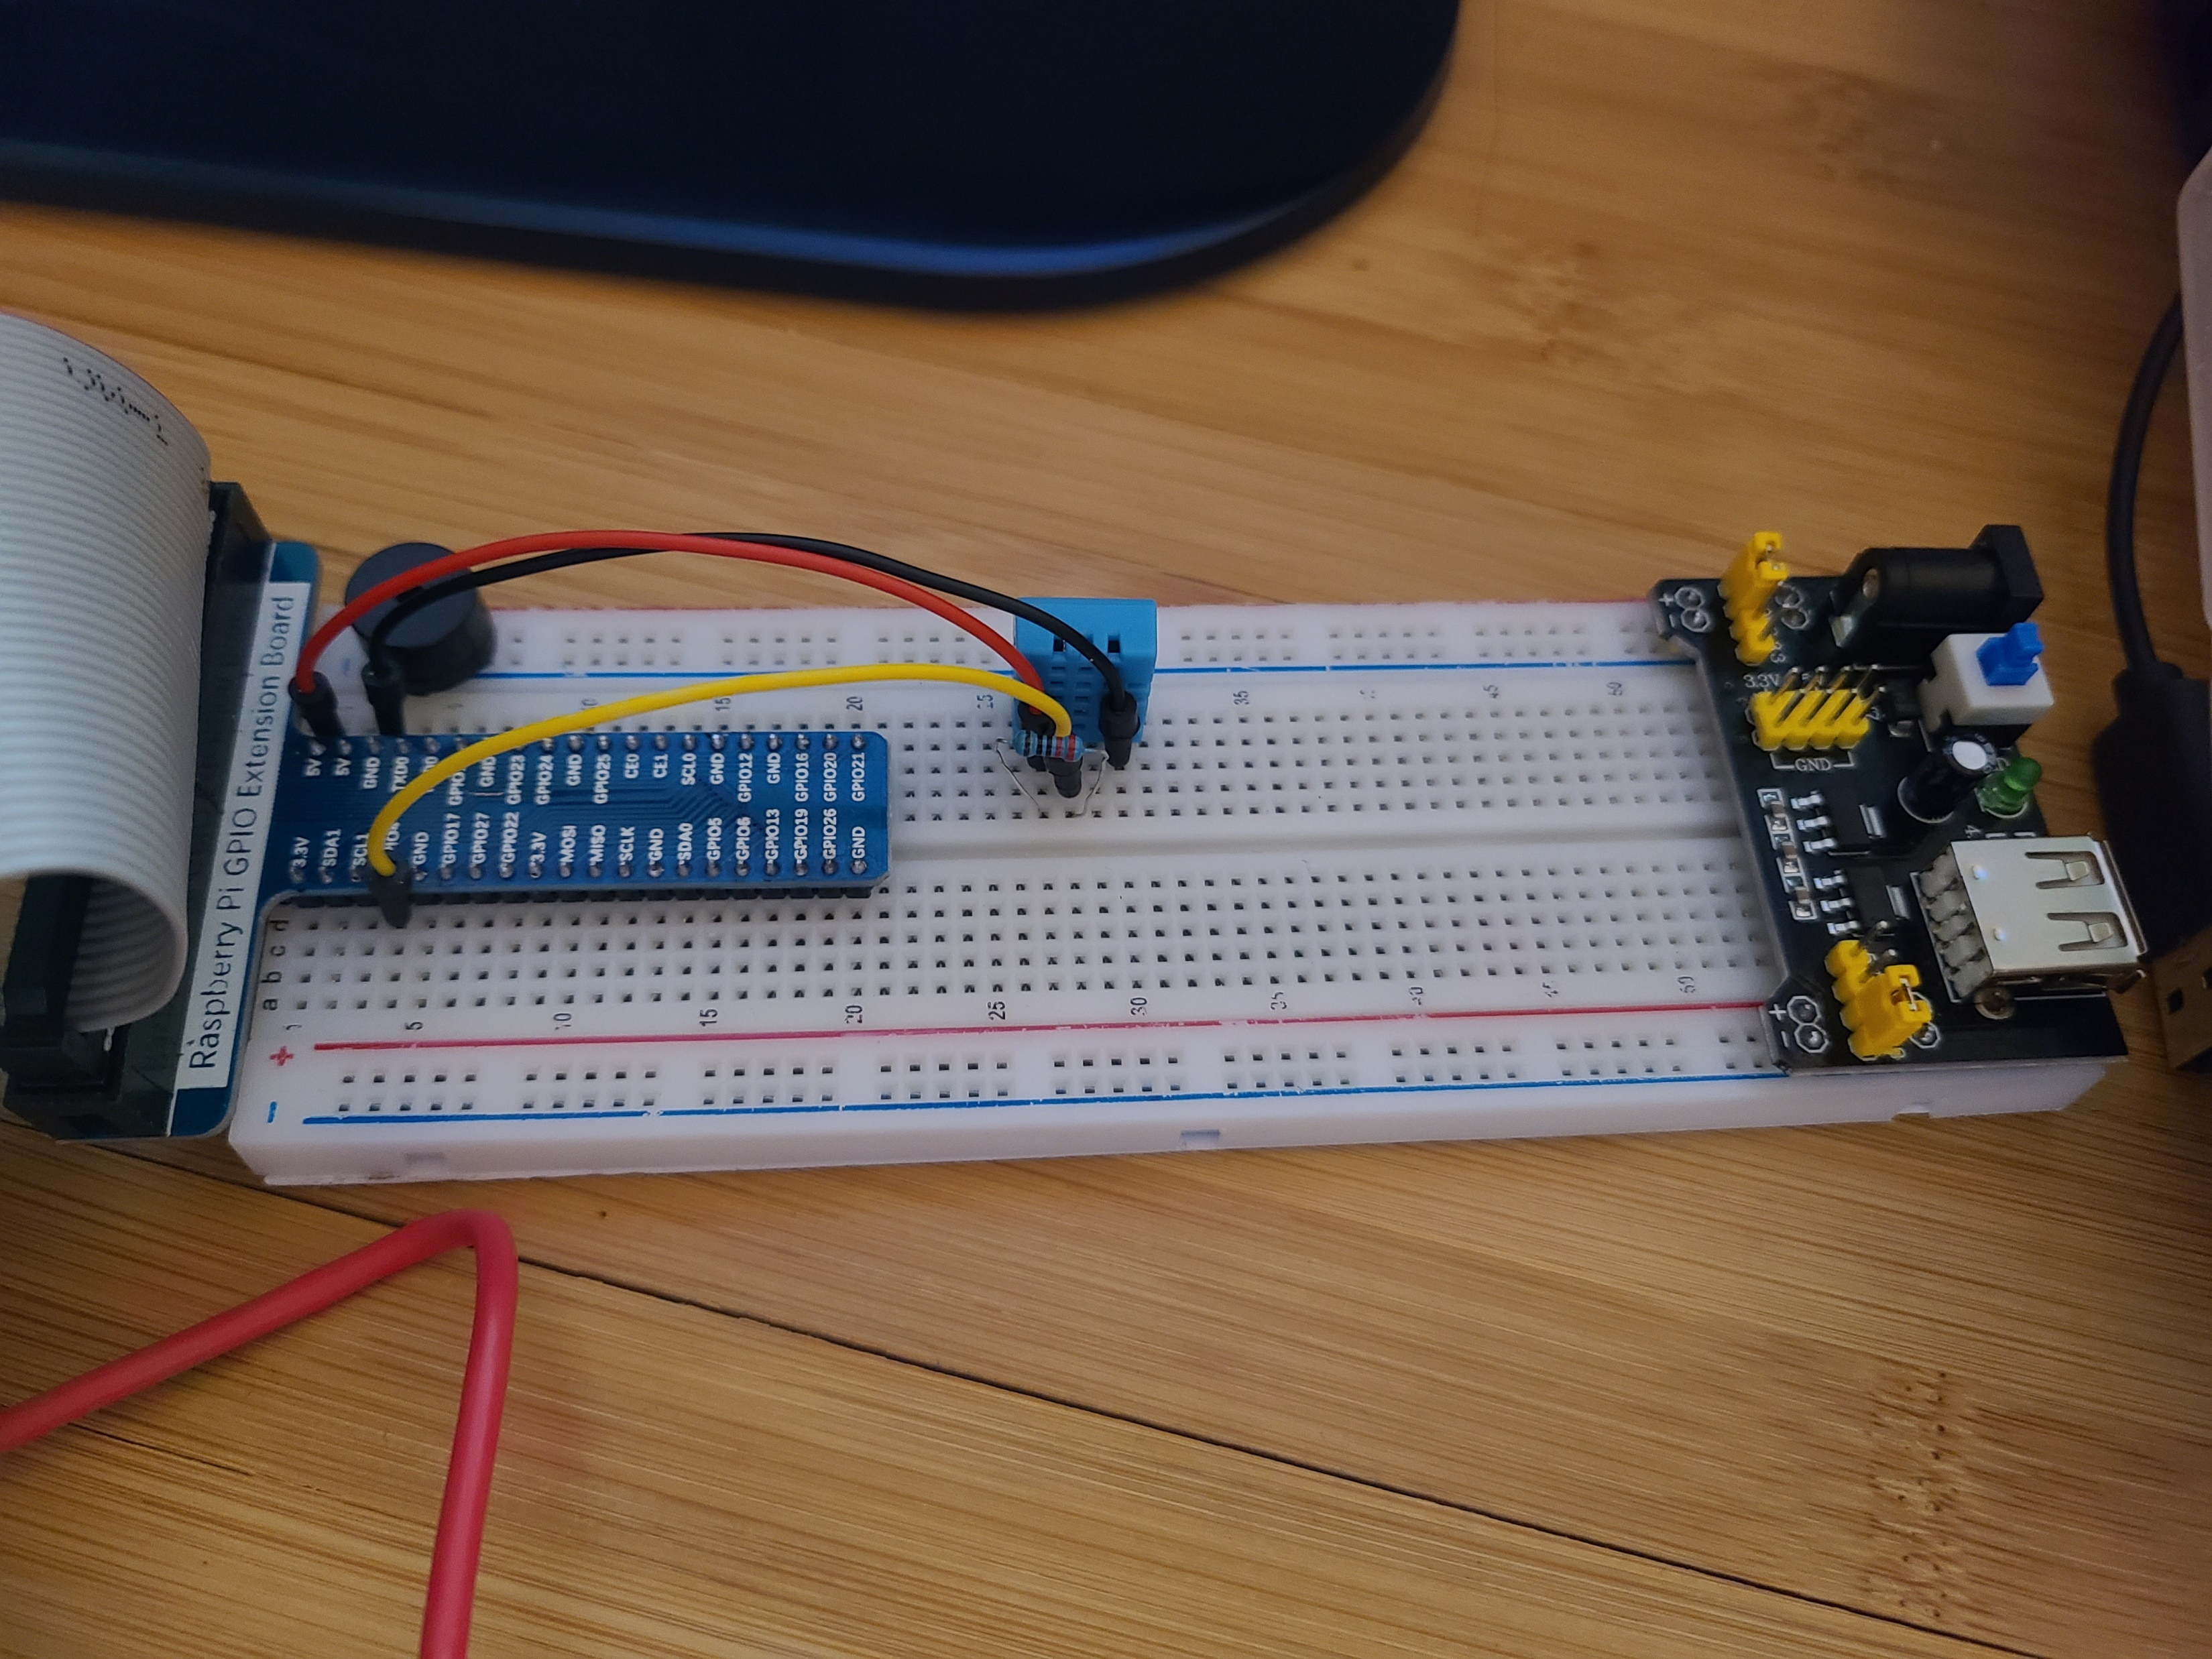
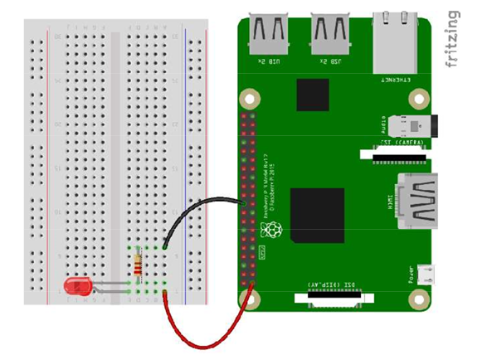
Phase 1
Tasks to be implemented in the first phase:
Create a dashboard
Data capture for the light intensity

Slide 7
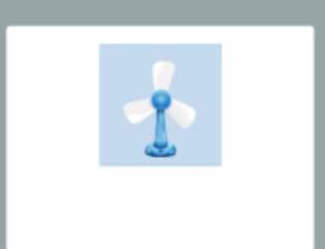
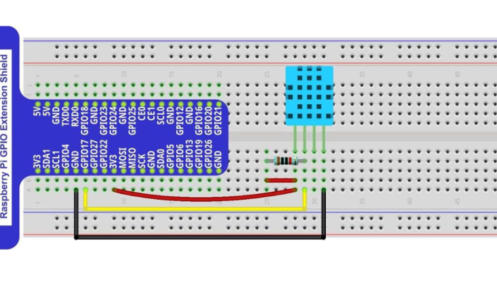
Phase 2
Tasks to be implemented in the second phase:
Add a DHT-11 temperature and humidity sensor
Data capture for the DHT-11 and a fan

Slide 8
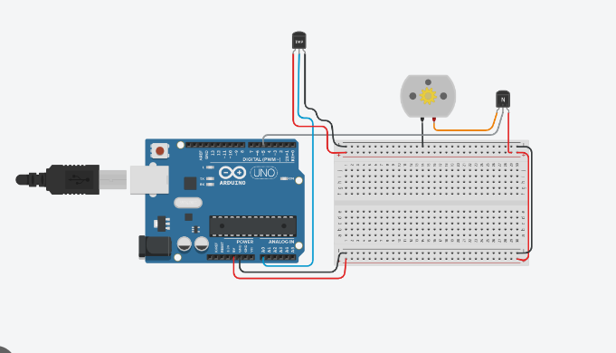
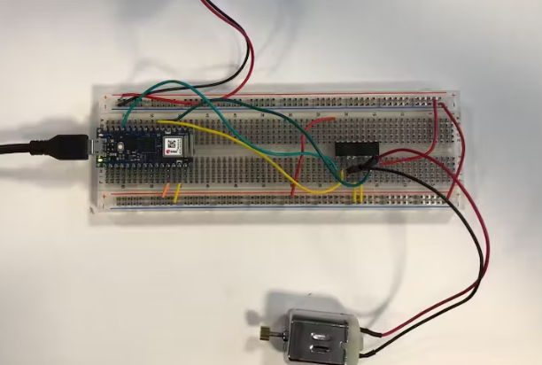
Phase 3
Tasks to be implemented in the third phase:
Install a DC motor on the dashboard
Send an Email to notify the fan is on

Slide 9
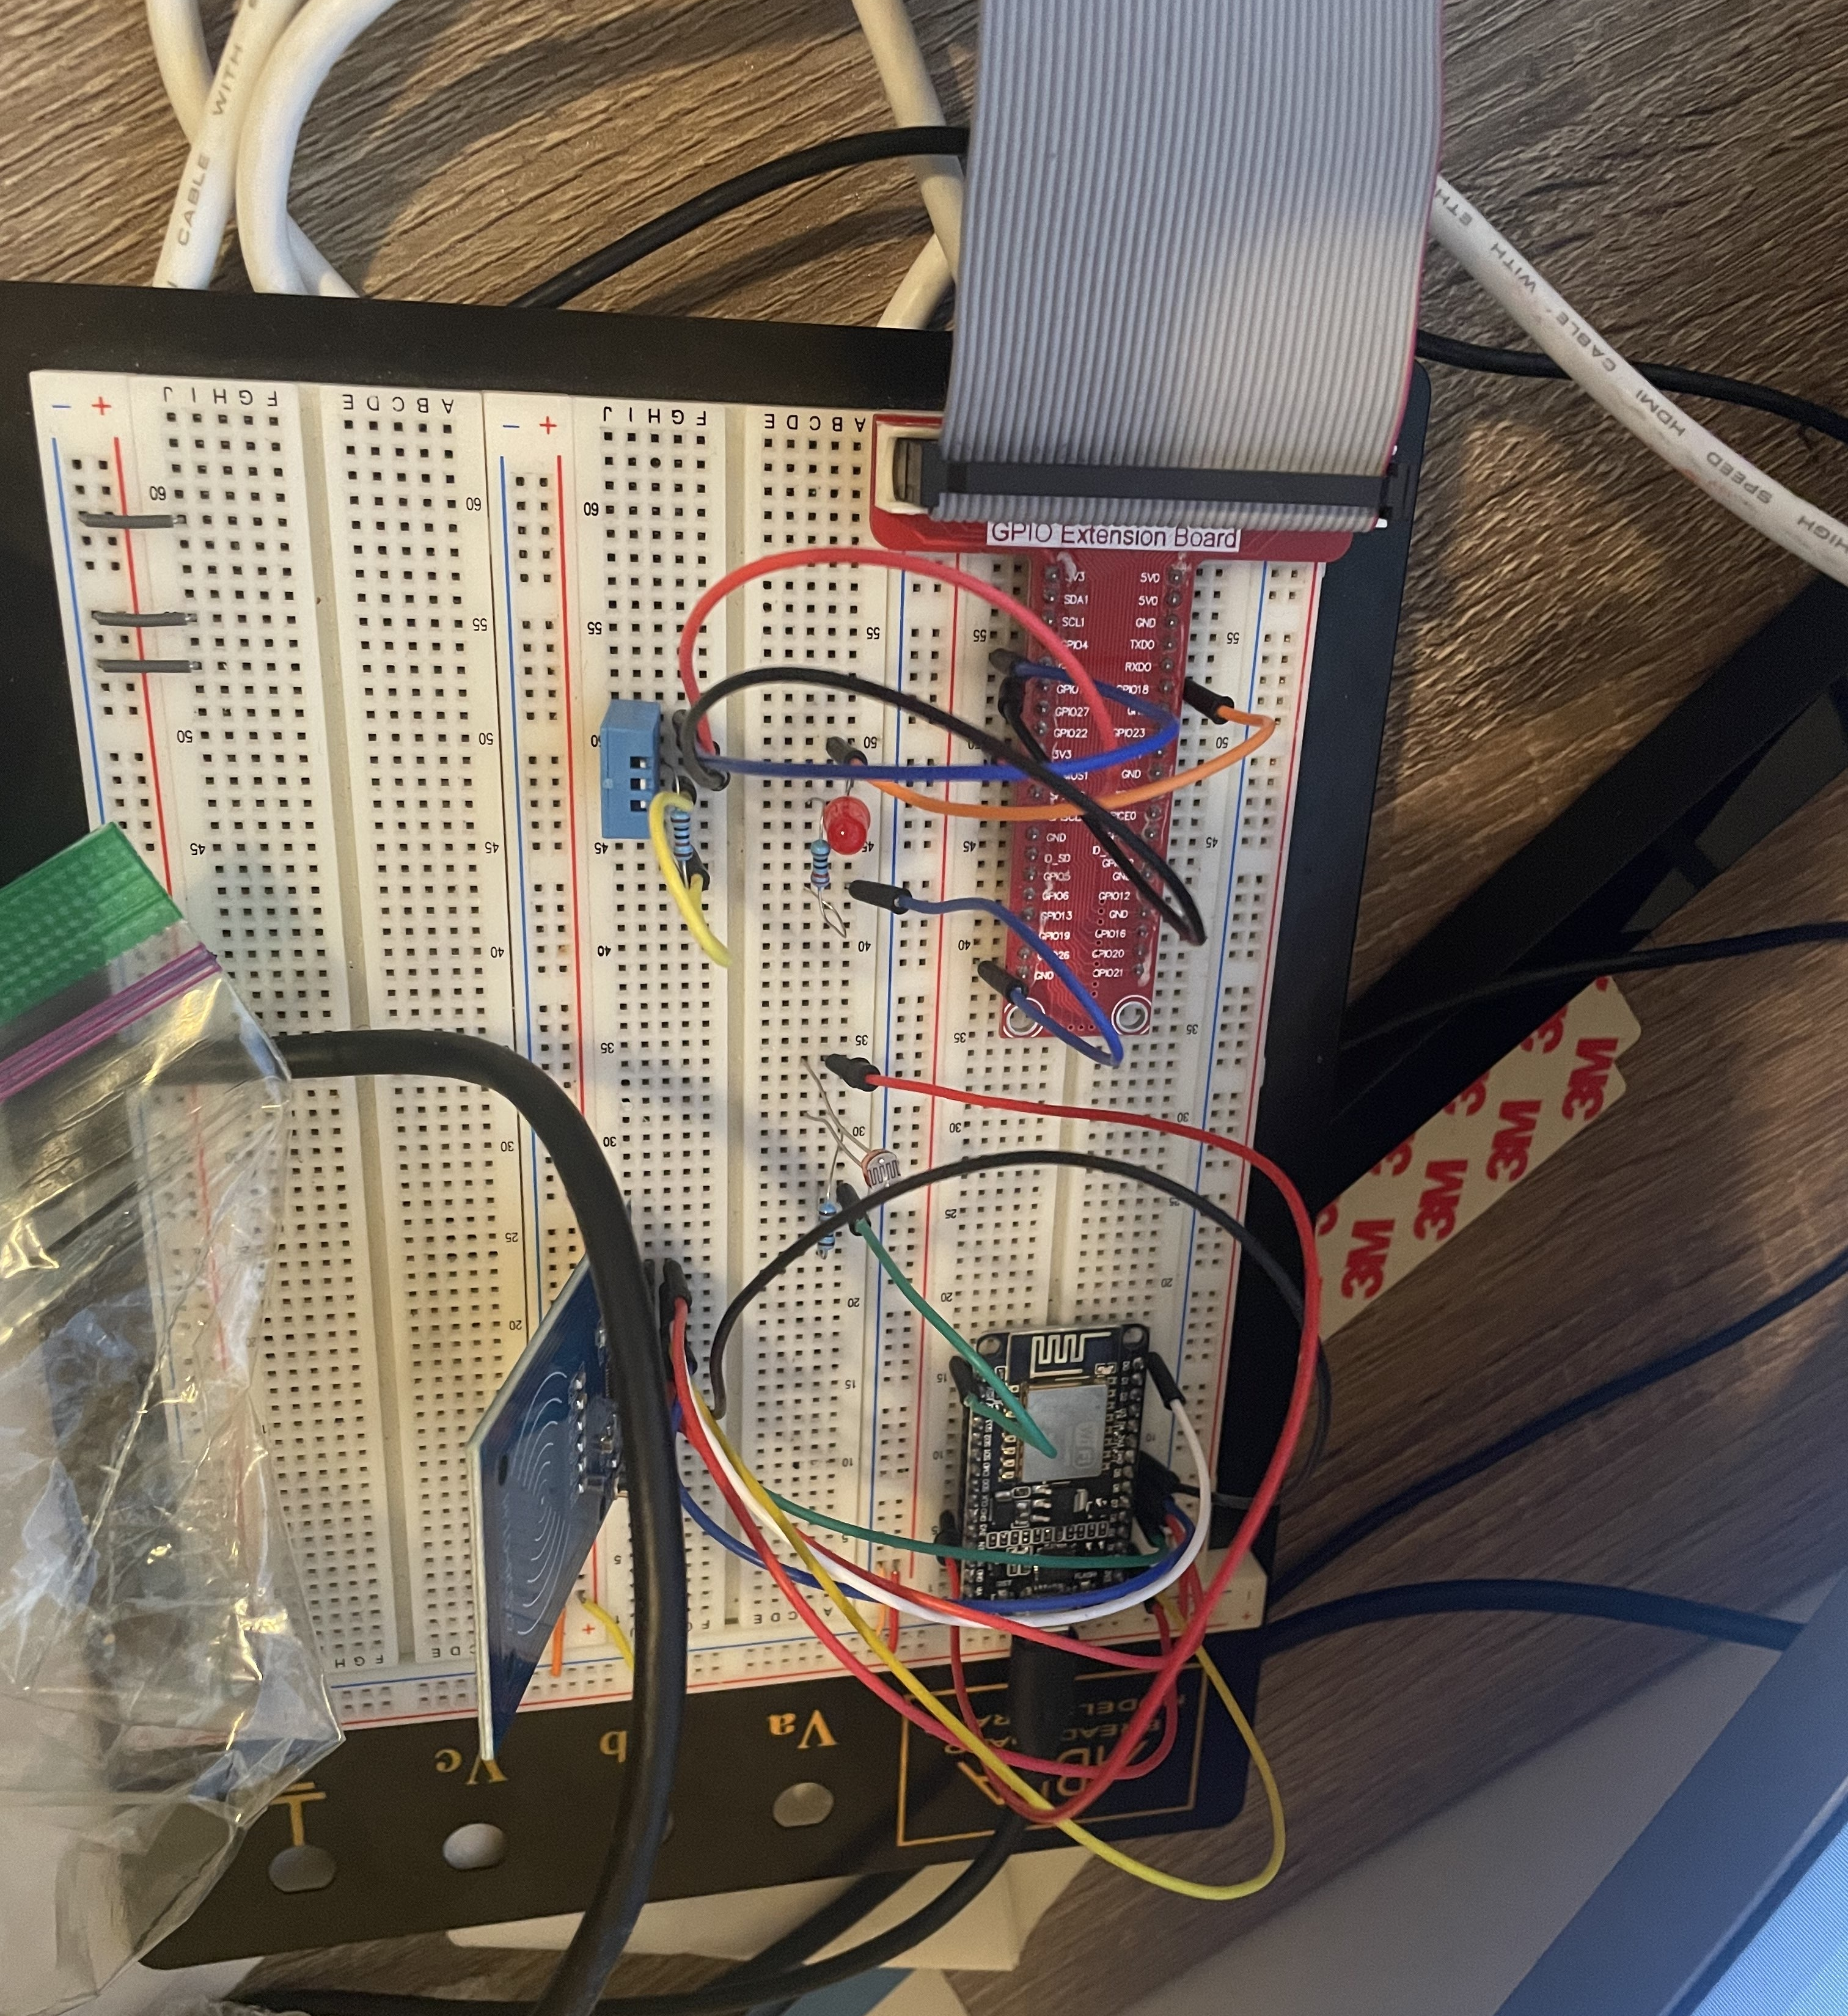
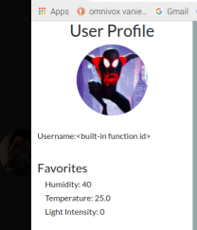
Phase 4
Tasks to be implemented in the fourth phase:
Install RC522 RFID module
Change User depends on Tag Unique ID
Changed desired values based on the user

Slide 10
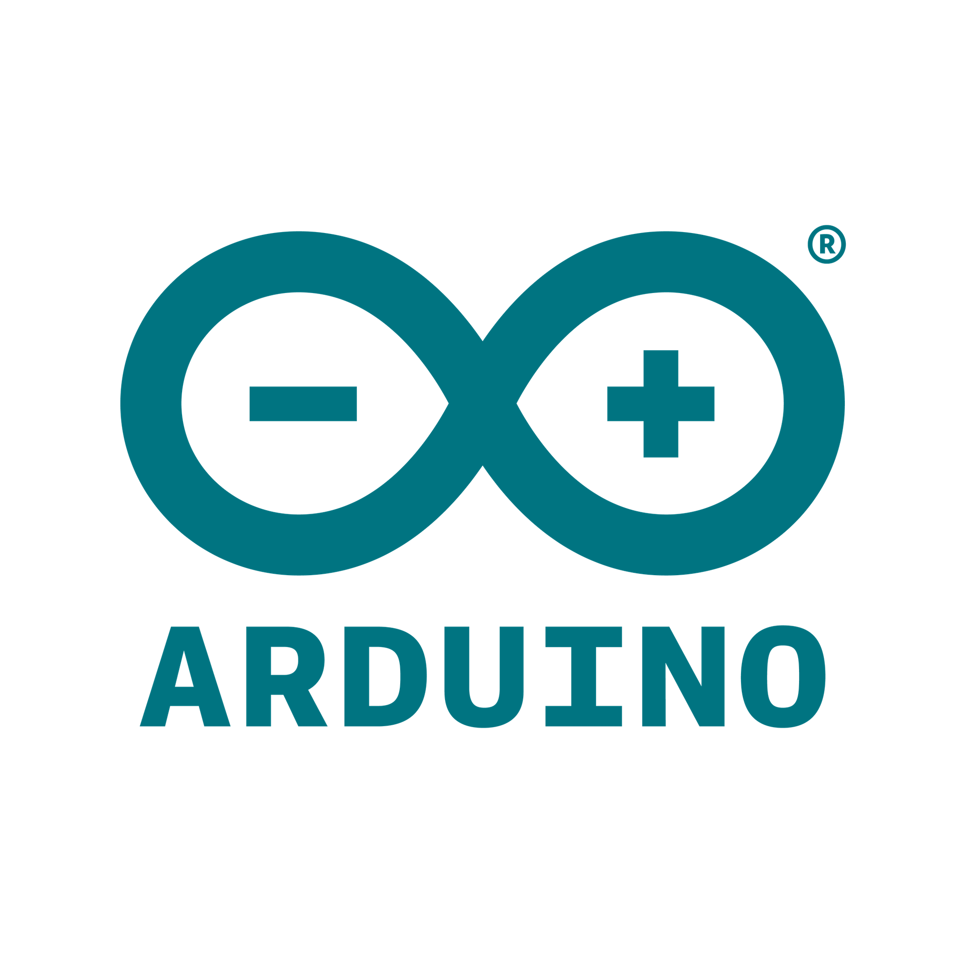




Used Software
Arduino
Node-Red
Thonny
Plotly
SQLite
Fritzing

Slide 11
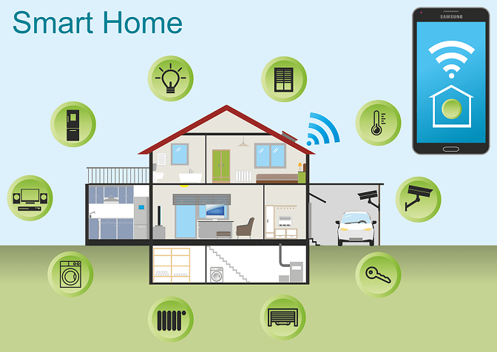
Result
features are were implemented in my project include :
E-Mail notification feature
Temperature, humidity, light intensity and fan
Communication between Raspberry Pi and ESP 32
profile management using RFID tags and SQL database

Slide 12
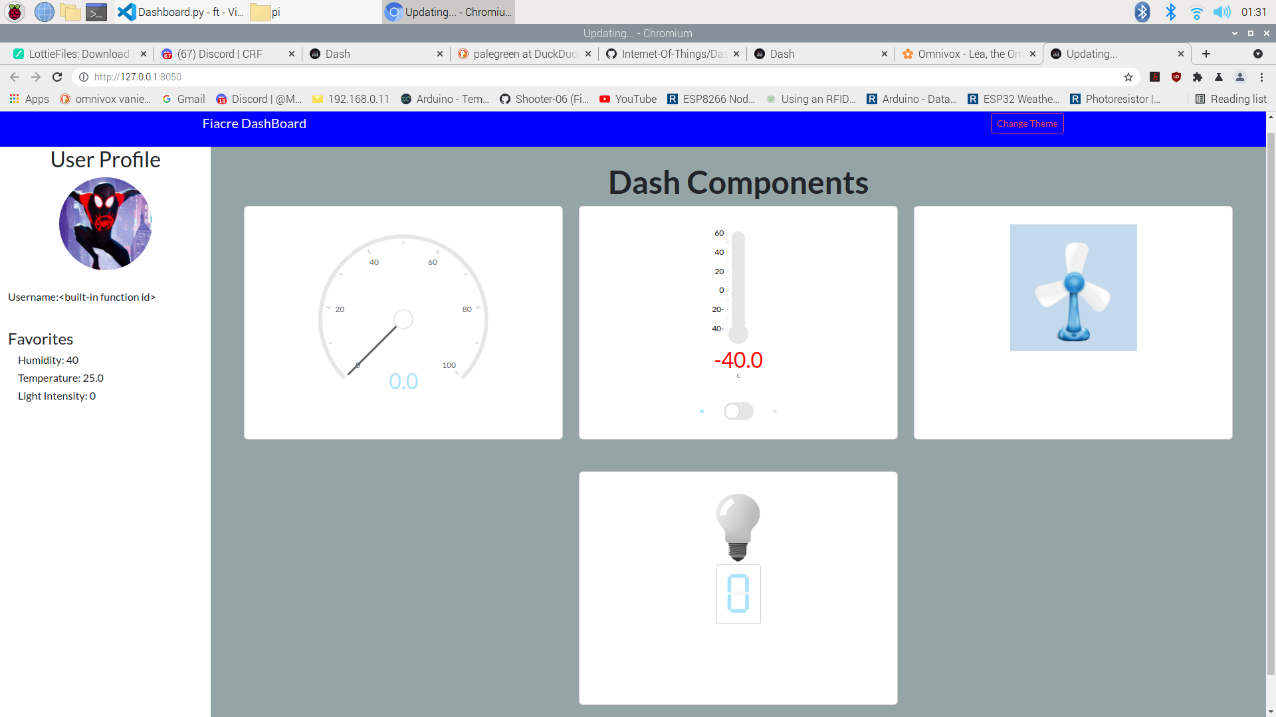
Result

Slide 13
Challenges
Increased workload
Time management
Limited perspective
Limited resources

Slide 14

Summary
What I learn in this project:
Using IoT features and the interaction with Arduino and Python
Self-discipline and time management
Attention to details
Perseverance and resilience

